Slide 1
Online Methods Workshop
Exploring Political Discourse through the Collection and Analysis of Digital Texts

Slide 2
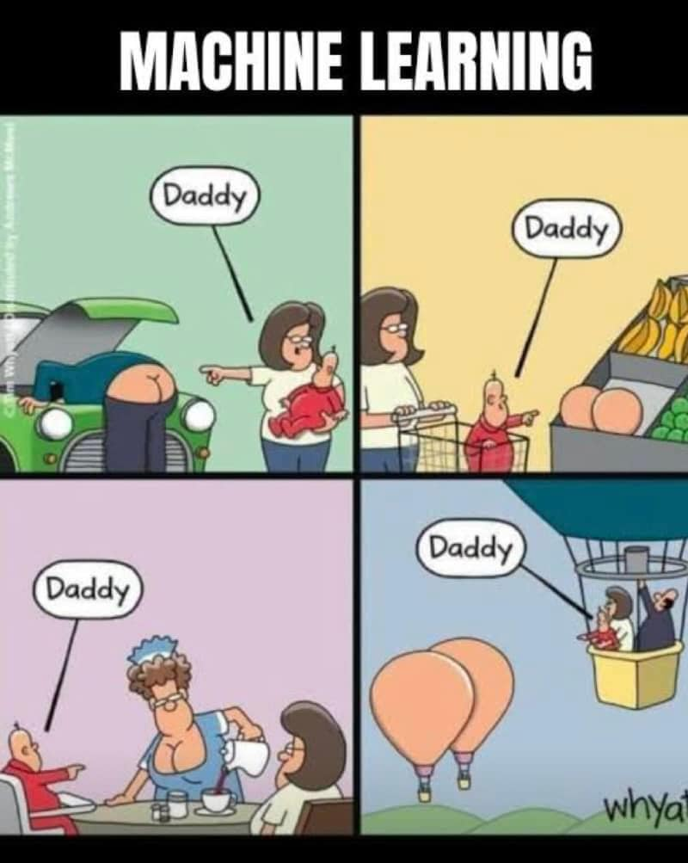
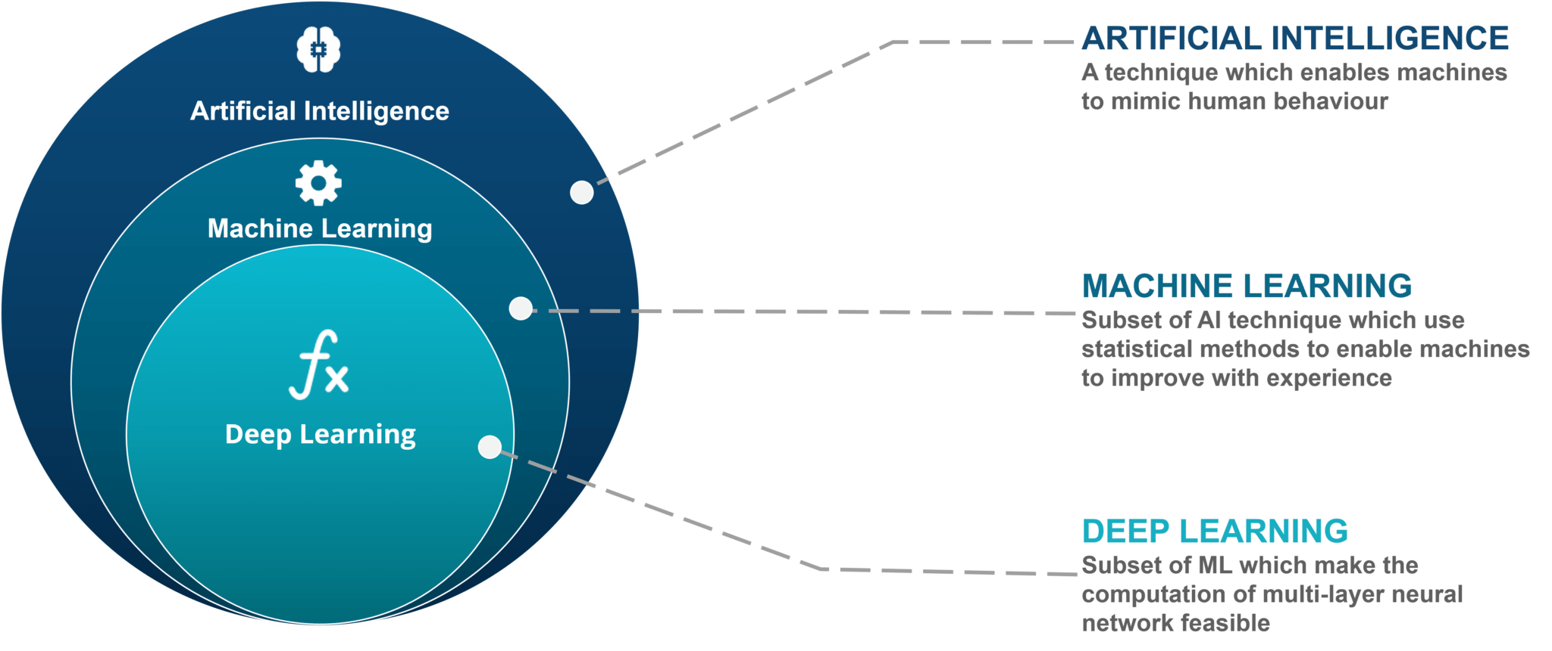
G3 Before we move on…
Not so proudly copy-pasted from here
Notes:
QTA methods can be classified in several ways

Slide 3

A map
Text collection
Preprocessing
Research Objective
Classification
Scaling
Known Categories
Unknown Categories
Supervised ML
Unsupervised ML
Dictionary Methods
Supervised ML
Unsupervised ML
Semi-supervised ML
LLMs

Slide 4
Today’s quest
Text collection
Preprocessing
Research Objective
Classification
Scaling
Known Categories
Unknown Categories
Supervised ML
Unsupervised ML
Dictionary Methods
Supervised ML
Unsupervised ML
Semi-supervised ML
LLMs

Slide 5


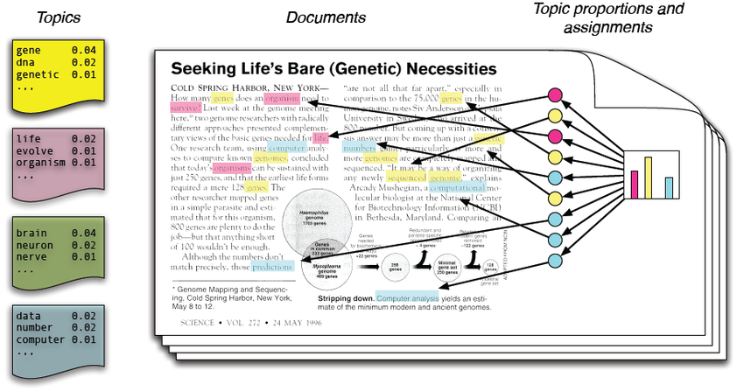





Collection
Preprocessinging
Research Objective
Classification
Unknown Categories
Organize texts according to their topics
Task:
Topics:
Unsupervised ML models for
Topic Modelling
Methods for discovering latent structures (e.g., topics) in your data (e.g., texts)
Some important limitations:
You must specify the number of topics before you start the analyses
Those distributions are estimated only relying on words co-occurrences
Only qualitative “checks” (validation)
Output:
A distribution of words per topic – or, probability that a word is in a given topic
A distribution of topics per document – how probable is that a text contains a topic
Notes:
e.g. Latent Dirichlet Allocation
Bayesian generative hierarchical model
First introduced as a way to simultaneously model traits and genes (Pritchard,
2000)
Adjusted for text analysis ML applications (Blei et al., 2003)

Slide 6


Collection
Preprocessinging
Research Objective
Classification
Known Categories
Organize texts according to their topics
Task:
word | topic
green | climate
immig* | migration
FFF | climate
border* | migration
pay gap | gender
… | …
20% climate
30% migration
02% gender
Topics:
10% climate
50% migration
02% gender
word search
& match
70% climate
10% migration
15% gender
Supervised Methods
Dictionaries
Collections of key-value pairs
e.g., word-topic
Most important limitation:
It’s just that!
Notes:
e.g. Latent Dirichlet Allocation
Bayesian generative hierarchical model
First introduced as a way to simultaneously model traits and genes (Pritchard,
2000)
Adjusted for text analysis ML applications (Blei et al., 2003)

Slide 7

Collection
Preprocessinging
Research Objective
Classification
Known Categories
Organize texts according to their topics
word | topic
green | climate
immig* | migration
FFF | climate
border* | migration
pay gap | gender
… | …
Task:
“Training” data
e.g., 80% of your words
Model training
The model updates its parameters from patterns in the data
Topics:
“Validation” data
e.g., 20% of your words
Supervised ML Models
Classifiers
Collections of key-value pairs
e.g., word-topic
Some important limitations:
Tons of manually annotated data
Specific and relatively simple classification tasks
These models usually outperform dictionary methods in classifying
Notes:
e.g. Latent Dirichlet Allocation
Bayesian generative hierarchical model
First introduced as a way to simultaneously model traits and genes (Pritchard,
2000)
Adjusted for text analysis ML applications (Blei et al., 2003)

Slide 8
Destination: Large Language Models
Text collection
Preprocessing
Research Objective
Classification
Scaling
Known Categories
Unknown Categories
Supervised ML
Unsupervised ML
Dictionary Methods
Supervised ML
Unsupervised ML
Semi-supervised ML
LLMs

Slide 9

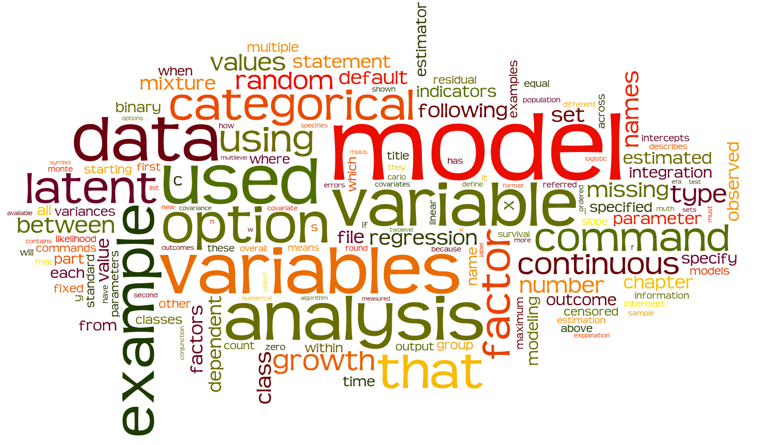
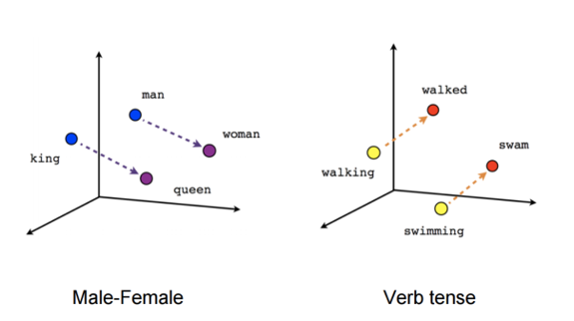
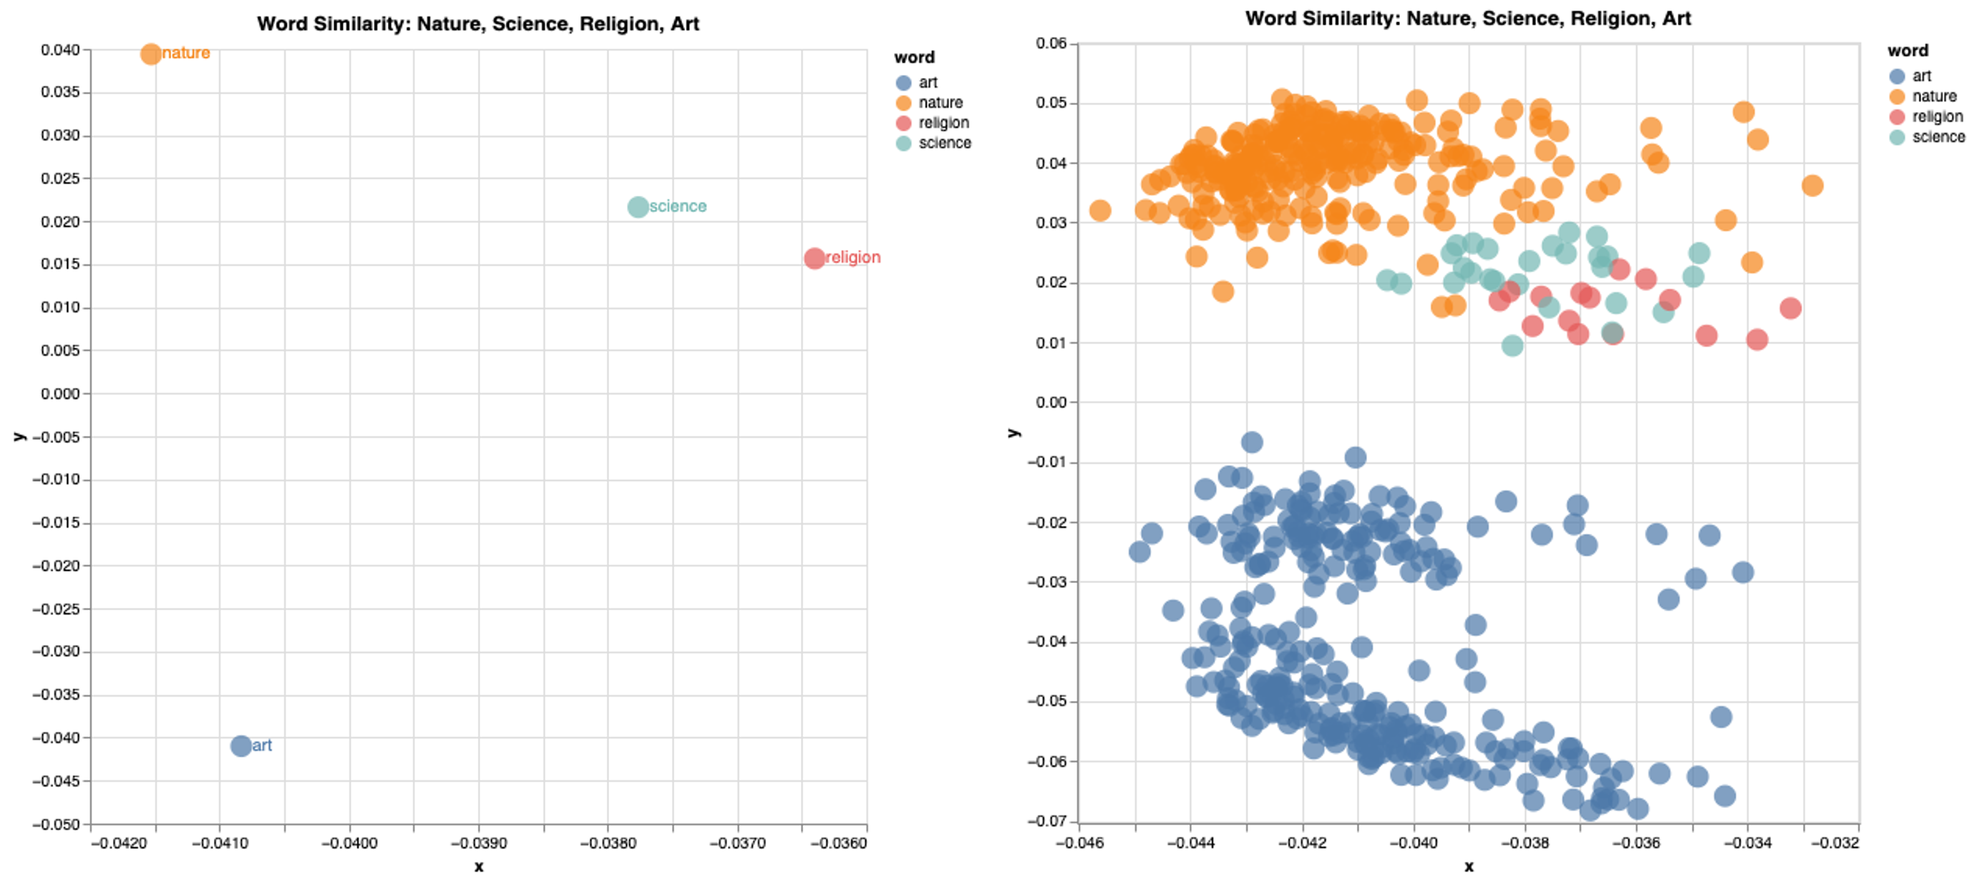
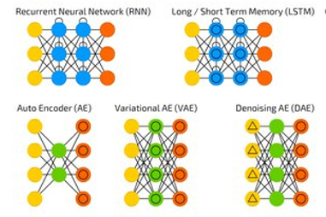
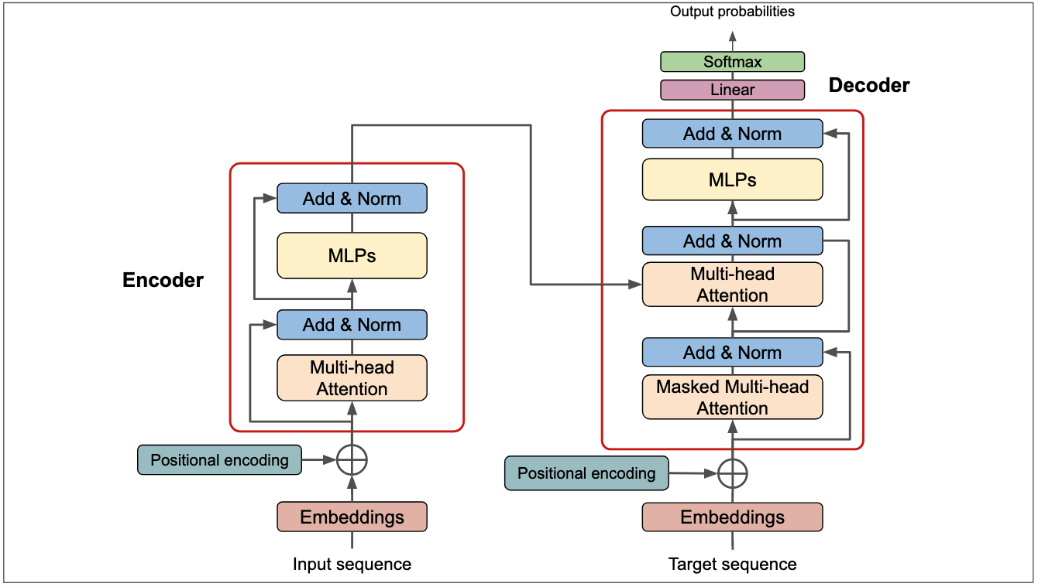
Destination: Large Language Models
Classical QTA Methods
LLMs
Zero knowledge
Shallow knowledge
Deep knowledge
(Models) Language
Knowledge
Bag of Words
Static Word Embeddings
Contextual Embeddings
LDA
LSS
Algorithm
Architectures
Naïve Bayes
Logistic
SVM
…
…
…
Neural Networks
Transformers
Notes:
Observe semantic variation of words between contexts different
Reducing the complexity of the data to extract knowledge from the information

Slide 10
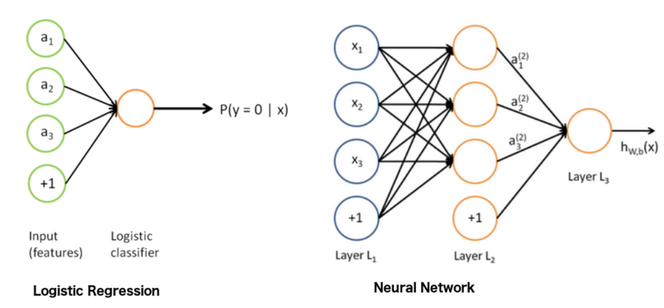
Destination: Large Language Models
Logistic regression
Neural Networks
Transformers
Notes:
Observe semantic variation of words between contexts different
Reducing the complexity of the data to extract knowledge from the information

Slide 11
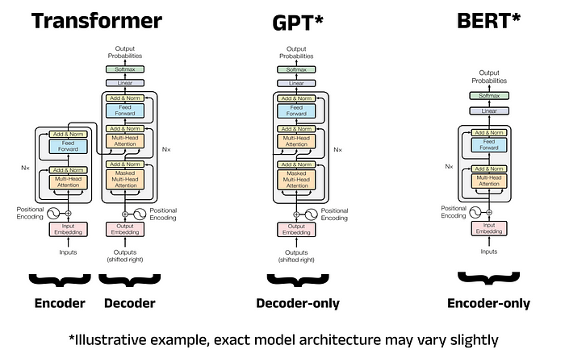
Destination: Large Language Models
Notes:
Observe semantic variation of words between contexts different
Reducing the complexity of the data to extract knowledge from the information

Slide 12
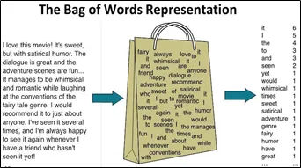
Destination: Large Language Models
Bag of Words
Static Word Embeddings
Contextual Embedddings
Notes:
Observe semantic variation of words between contexts different
Reducing the complexity of the data to extract knowledge from the information

Slide 13
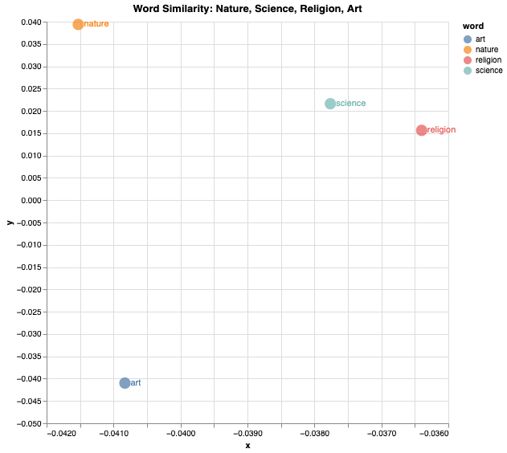
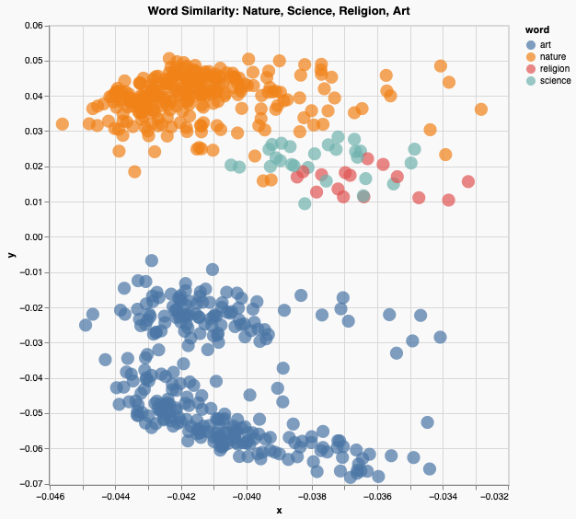
Destination: Large Language Models
Bag of Words
Static Word Embeddings
Contextual Embedddings
the nature of philosophie
against nature can persuade
imparting science, or celestial truth
what lessons science waits to teach
theirs is a mixt religion
when art was sacred
made rhyme an art
thou art to me a fly
art thou not prone
Notes:
Observe semantic variation of words between contexts different
Reducing the complexity of the data to extract knowledge from the information

Slide 14
Destination: Large Language Models
Feature | Static embeddings (e.g., word2vec, GloVe) | Contextual embeddings (e.g., BERT, RoBERTa)
Dimensions | Fixed, chosen at training (e.g., 100–300) | Fixed, chosen by model design (e.g., 768 in BERT-base, 1024 in BERT-large)
Representation | One vector per word type (same for all contexts) | One vector per word occurrence (changes with context)
Meaning captured | Average/general meaning of a word | Context-dependent meaning (disambiguates polysemy, homonymy)
Training | Predict words from context (skip-gram, CBOW) or co-occurrence (matrix factorisation) | Deep neural network with attention, trained on masked language modelling and/or next sentence prediction
Advantages | Simple, computationally cheap, useful for many tasks | Richer representations, better performance on NLP tasks
Limitations | Cannot distinguish senses of a word; ignores context | Larger models, more computationally expensive
Notes:
Observe semantic variation of words between contexts different
Reducing the complexity of the data to extract knowledge from the information

Slide 15



Destination: Large Language Models
Classical supervised
methods
Contemporary
supervised
methods
Text
Human
annotators
Input
Preproc. and
annotated text
ML model
Output
Estimates
Task specific
TRAINING
ML model
Multipurpose
TRAINING
FINE-TUNING
Notes:
Observe semantic variation of words between contexts different
Reducing the complexity of the data to extract knowledge from the information

Slide 16
Destination: Large Language Models
Classical supervised
methods
Contemporary
unsupervised
methods
Text
Human
annotators
Input
Preproc. and
annotated text
ML model
Output
Estimates
Task specific
TRAINING
ML model
Multipurpose
TRAINING
FINE-TUNING
Notes:
Observe semantic variation of words between contexts different
Reducing the complexity of the data to extract knowledge from the information

Slide 17
Annotation: aka, a neverending nightmare
STEP 0
Unitization
STEP 1
STEP 2
STEP 3
STEP 4
STEP 5
STEP 6
STEP 7
Classification
Gender-related q.s.?
Domain and category?
Recipient gender & sexuality?
Intersectio-nality?
Stance?
Goal? Issue? Policy?
What kind of policy?
No
(next)
D. 1
C. 1
Woman
Religion
Support
Goal
Regulation
Man
Neutral
Yes
D. 1
C. 3
…
Sexuality
Issue
Reliefs, resources,
Hetero.
…
D. 1
C. 2
Age
No s.
Policy
Homo.
…
…
…
…
…
Cis.
Trans.
…

Slide 18
LLMs application: an example
We rely multilingual transformer-based deep learning models:
XLM-RoBERTa [flat, hierarchical]
manifestoBERTa [flat, hierarchical]
Sentence-level multiclass classification tasks on 8 classes:
Manifestos: 210 documents, ~100k sentences, 25 languages
Datasets: 29, 2 versions each
Data samples: 4 different seeds, 380 sentences (80% training, 20% validation)
Epochs: 3
Batch size: 64, 128
Hidden state size: 64, 128
3712 runs
1 – EU residual
2 – EU enlargement
3 – EU solidarity
4 – EU single market
5 – EU competences
0 – Residual
6 – Immigration
7 – Environment
Best 4 models on F1: Two models * version (flat/hierarchical)
Epochs: until performance increases

Slide 19

LLMs application: an example
We select the best performing model on test macro f1 score
Test data
Manual annotation
Coders: 4 RAs
Manifestos: Germany, 2024
Sentences: 2000 (500 x coder)
Classes: 4 (EU, Immigration, Environmnent, Other)
EM2024 data
Manifestos: 73
Countries: 9 (Austria, Czech Republic, Denmark, Finland, France, Germany, Greece, Italy, Spain)

Slide 20
Hands-on Examples
Today we will go through this AGAIN* in this Google folder where we will:
Check the workflow
Set up all the model architectures,
Train a model (if we have time)
Use models for predictions
Compute some quantities of interest – and do some visualization?

Slide 21
🐬So long, and thanks for all the fish… 🐟
Feel free to contact me at:
📧 giuseppe.carteny@uni-saarland.de
🦋 @giucarny.bsky.social

